Slide 1
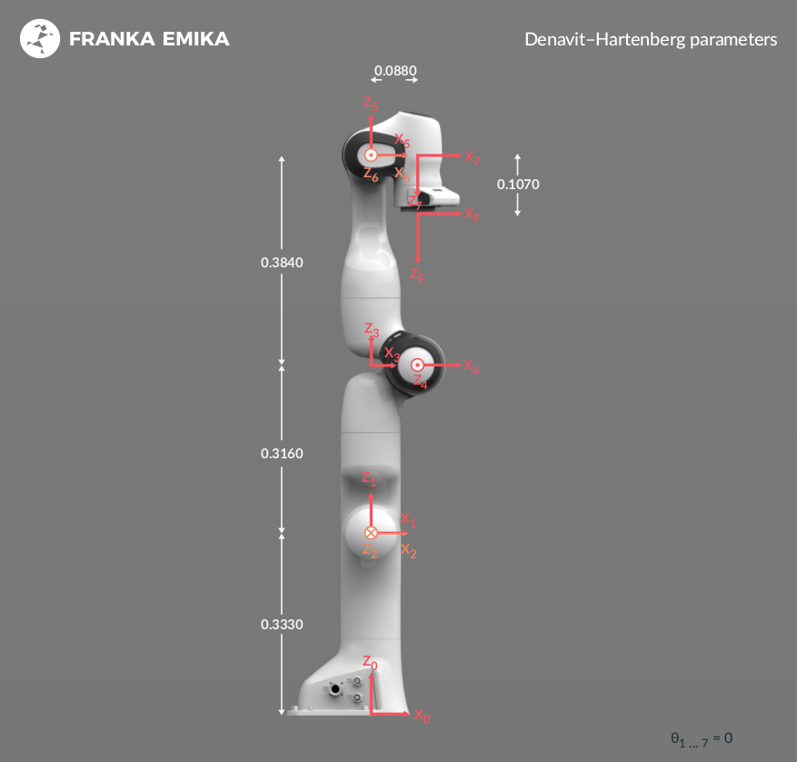
MOTION
PLANNING
ChessMate – ROMER
26.07.2023

Slide 2
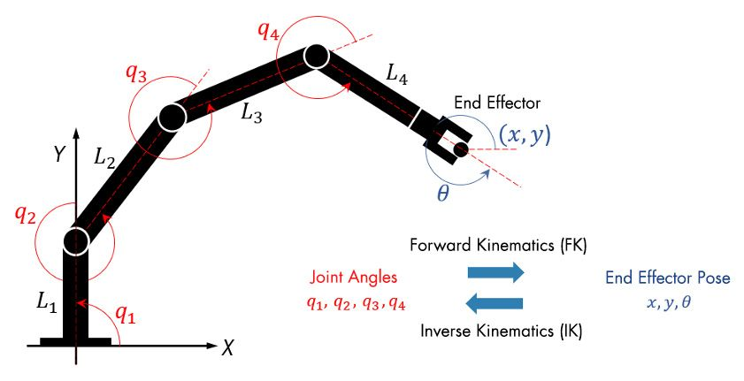
INVERSE KINEMATIC SOLVER
Why We Need IK Solver?
For desired robot’s end-effector positions, inverse kinematics (IK) can determine an appropriate joint angles for which the end-effectors move to the target pose. Also IK solver must be fast.

Slide 3
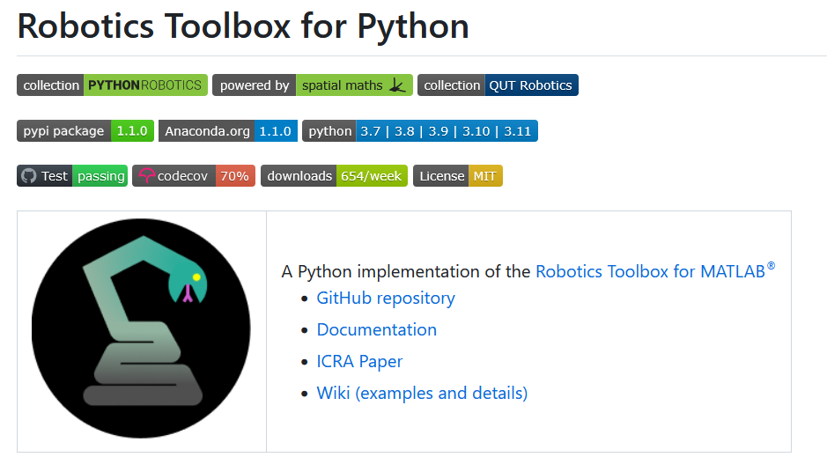

IK SOLVERS
We couldn’t visualize robot motion.
In our Python script robot move in a different trajectory and it was meaningless.
Visualize by Rviz.
Moveit using IKFast plugin based on C++ and it is more efficent. Also planner is works well with our Python script.
Easy to use.
It is suitable for our manipulator.

Slide 4
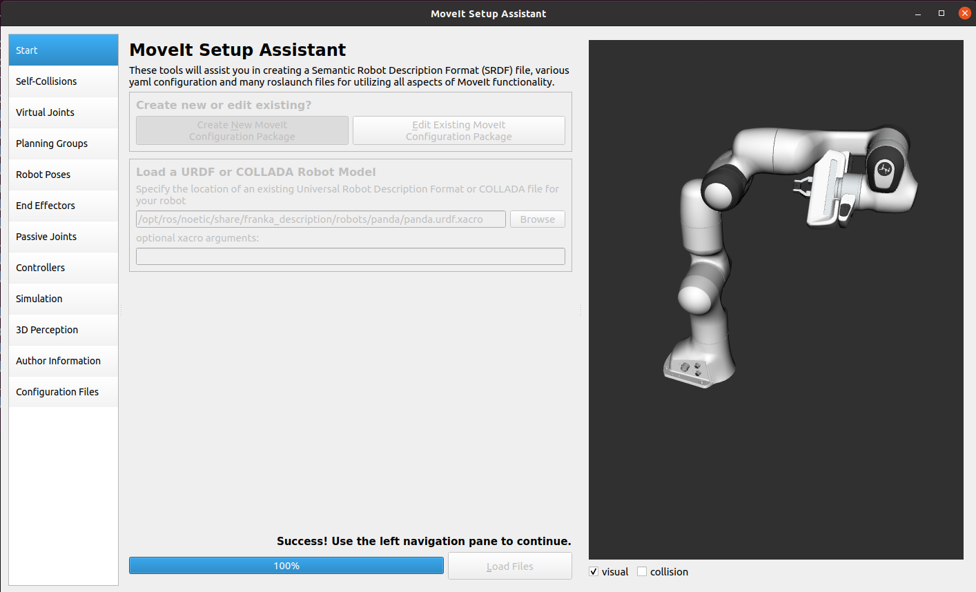
We added our .urdf file in Moveit and defined all links and joints to create configuration file which are generally include robot’s joint control parameters also some launch file created for gazebo and Rviz.

Slide 5
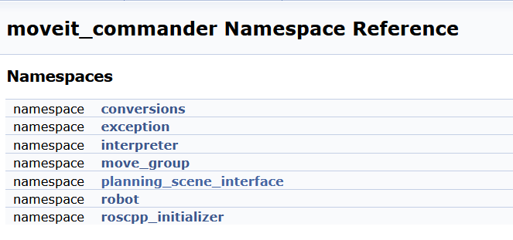
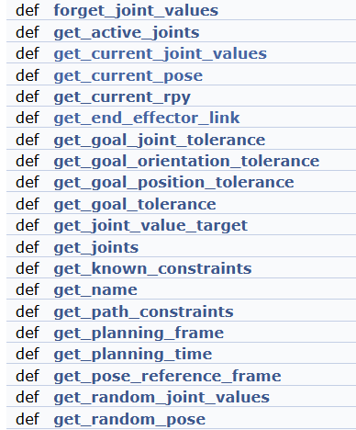
To get some information from robot such as current_pose, joint_values etc.. and also to set some values like a planner type we used moveit functions.

Slide 6
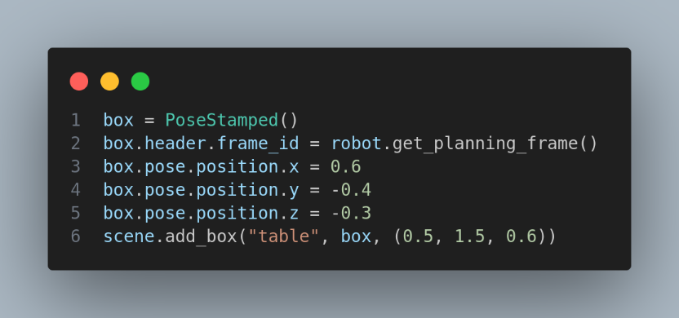
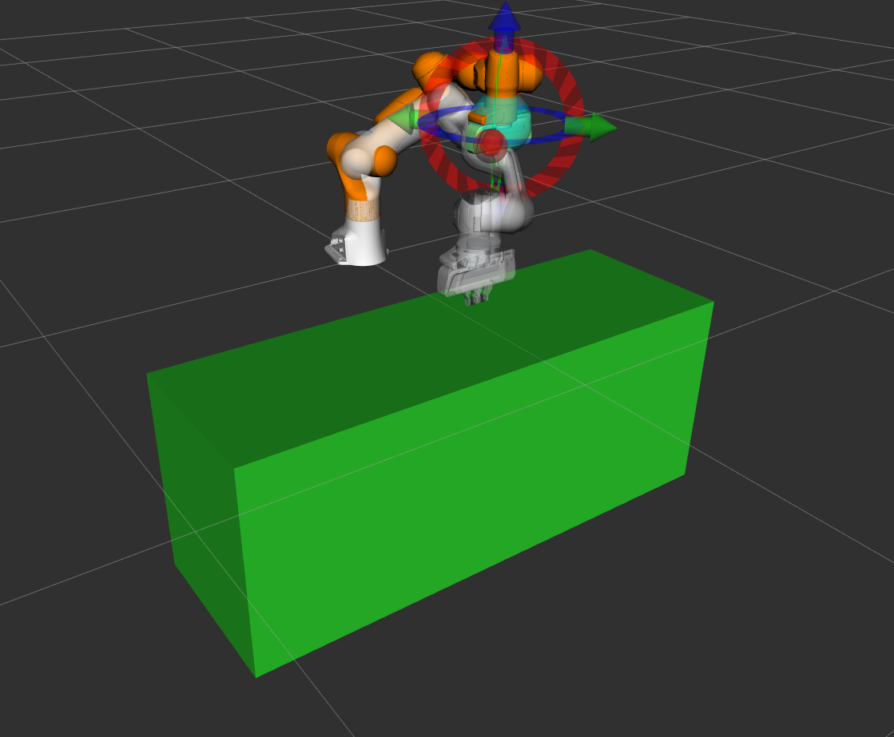
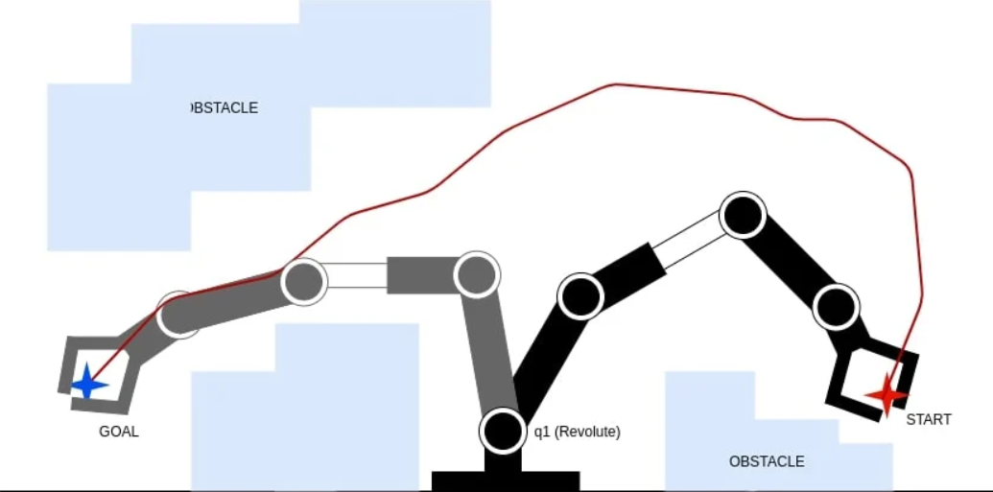
Problem 1: Obstacle Avoidance
Can robot sense table as a obstacle? Because sometimes robot moving with unexpected path it may hit the table.
Solution: To prevent that we have added object at underside of the robot with using moveit library.

Slide 7
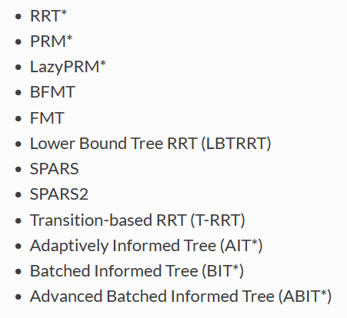
Problem 2: Which Planner Suitable for Our Project
Sometimes robot doesn’t make a path planning because of planner does not solve for given target. We generally use default parameter but we don’t know yet which planner suitiable for our project. The Open Motion Planning Library (OMPL) is a powerful collection of state-of-the-art sampling-based motion planning algorithms and is the default planner in MoveIt.
This is a goal biased RRT

Slide 8
Testing with Moveit
The end effector is going all square one by one

Slide 9
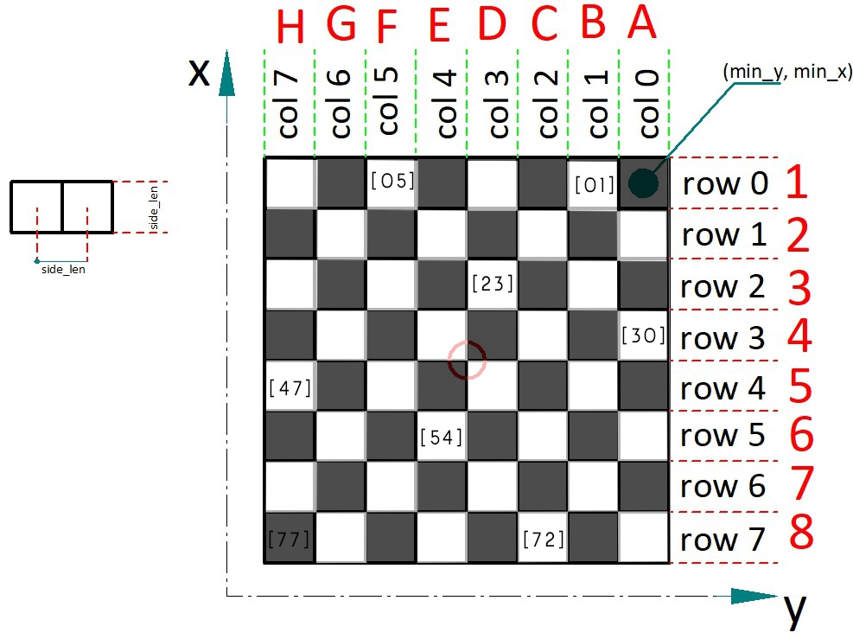
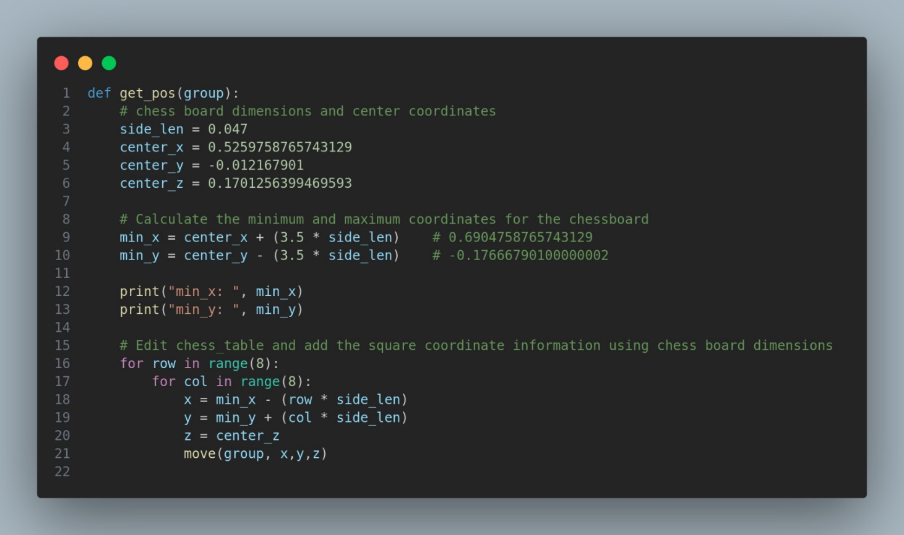
The Main Idea of Motion
Before all process we calculated center of chessboard and measured square side size. We can target any square which has known row and column number. Then using group.set_pose_target() function we can move robot and by the way we published these data to display topic to visualize on RVIZ.

